Slide 1
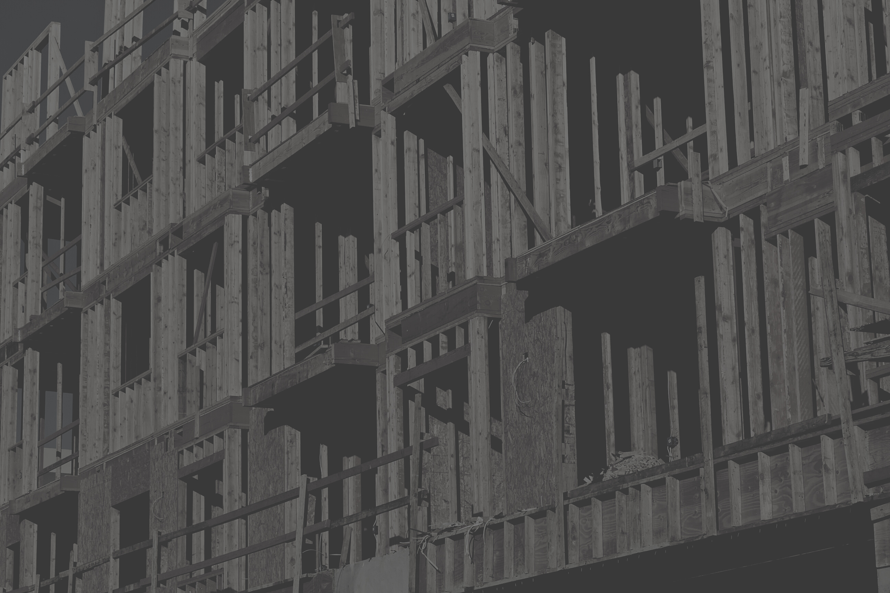

AMERICAN INTERNATIONAL UNIVERSITY–BANGLADESH (AIUB)
FACULTY OF SCIENCE & TECHNOLOGY
COMPUTER AIDED DESIGN & DRAFTING
Section: C Group: 8.
SHOPPING MALL DESIGN PROGECT
Summer 2020-2021
TA&D | Project Overview | 2020

Slide 2
Group Members
JWEL MIAH
MD.SALIM MOTASSIN SADMAN
1
3
ID: 20-43243-1
ID: 17-34938-2
NOKIBUL ARFIN SIAM
PARBOTI DAS PUJA
2
4
ID: 21-44793-1
ID: 21-44648-1

Slide 3

TABLE OF CONTANT
Introduction to autoCAD
What is Civil plan?
Shopping Mall Civil Design.
What is Electrical Fitting?
Shopping mall Electrical Fitting Design.
Conclution

Slide 4
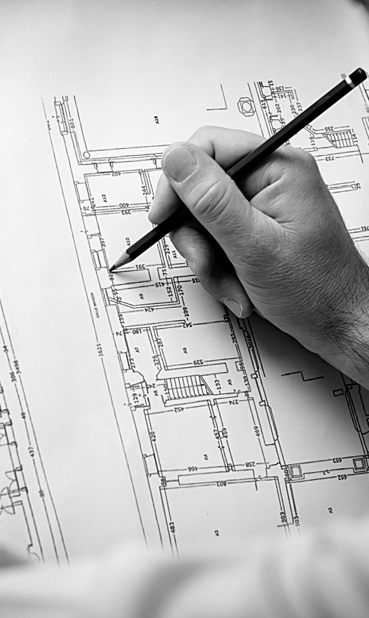
INTRODUCTION TO AUTOCAD
The Word AutoCAD is made up of two words “Auto(logo of company)” and CAD “(computer aided design)”.​
AutoCAD is 2D and 3D modelling software. ​
It is developed by Autodesk company .​
Autodesk is an U>S>A based company .​
It is widely used in industry for 2D drawing and 3D modeling.​
In another way we can say that AutoCAD is a designing course , which is performed by the help pf computer . ​

Slide 5

WHAT IS CIVIL PLAN?
​
A civil drawing, or site drawing, is a type of technical drawing that shows information about grading, landscaping, or other site details. These drawings are intended to give a clear picture of all things in a construction site to a civil engineer.​
Civil drafters work with civil engineers and other industry professionals to prepare models and drawings for civil engineering projects. Examples of civil engineering projects are bridges, building sites, roadways, public utility systems, and waterworks. ​

Slide 6
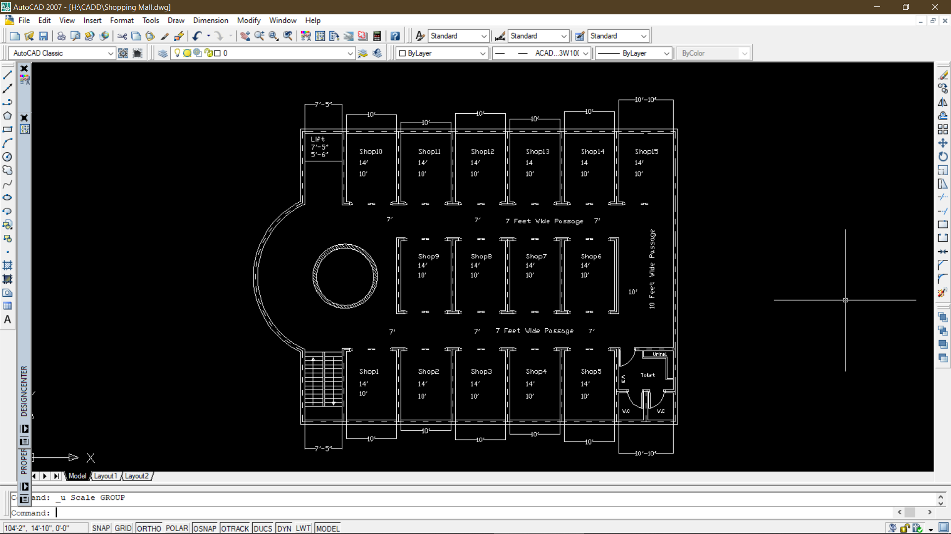

Slide 7
SHOPPING MALL CIVIL DESIGN
The number of shops 15
A Shop Size is 14'×10'
Walking passage 7' wide
Brick line to interior line is 5"
Brick line to exterior line is 5"
Interior to exterior line is 10"

Slide 8
WHAT IS ELECTRICAL FITTING?
Electrical Fittings are the products, which are used for fitting various electrical devices like switches, fans, wires, tube lights etc. These components are available in a wide variety of shapes and sizes and materials. Thus, electrical fittings are specifically designed considering various hazards.

Slide 9
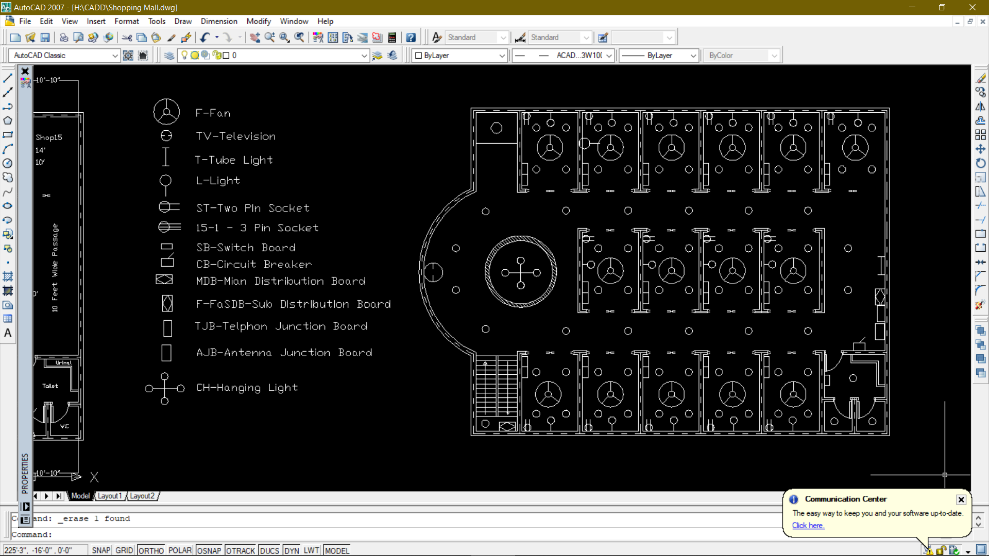

Slide 10
SHOPPING MALL ELECTRICAL FITTING
Fan, Television
Tube light, Light
Socket, Switch Board, circuit Breaker
Main Distribution Board, Sub Distribution Board
Telephone Junction Board, Antenna Junction Board
Hanging Light

Slide 11
SHOPPING MALL ELECTRICAL FITTING ANALYSIS
sidiedij
hewhewf
kdjfjkfjnef
kjdcfndcvnd

Slide 12

CONCLUSION
Conclusion. AutoCAD for Students is the most widely used computer-aided software for producing architectural drawings. It is not only on computers, but it is also available as a mobile app that has a huge demand and attracts many students and beginners.​
​
Here we have made a Shopping Mall design, where we have think about our comfort than any other things.​
​

Slide 13
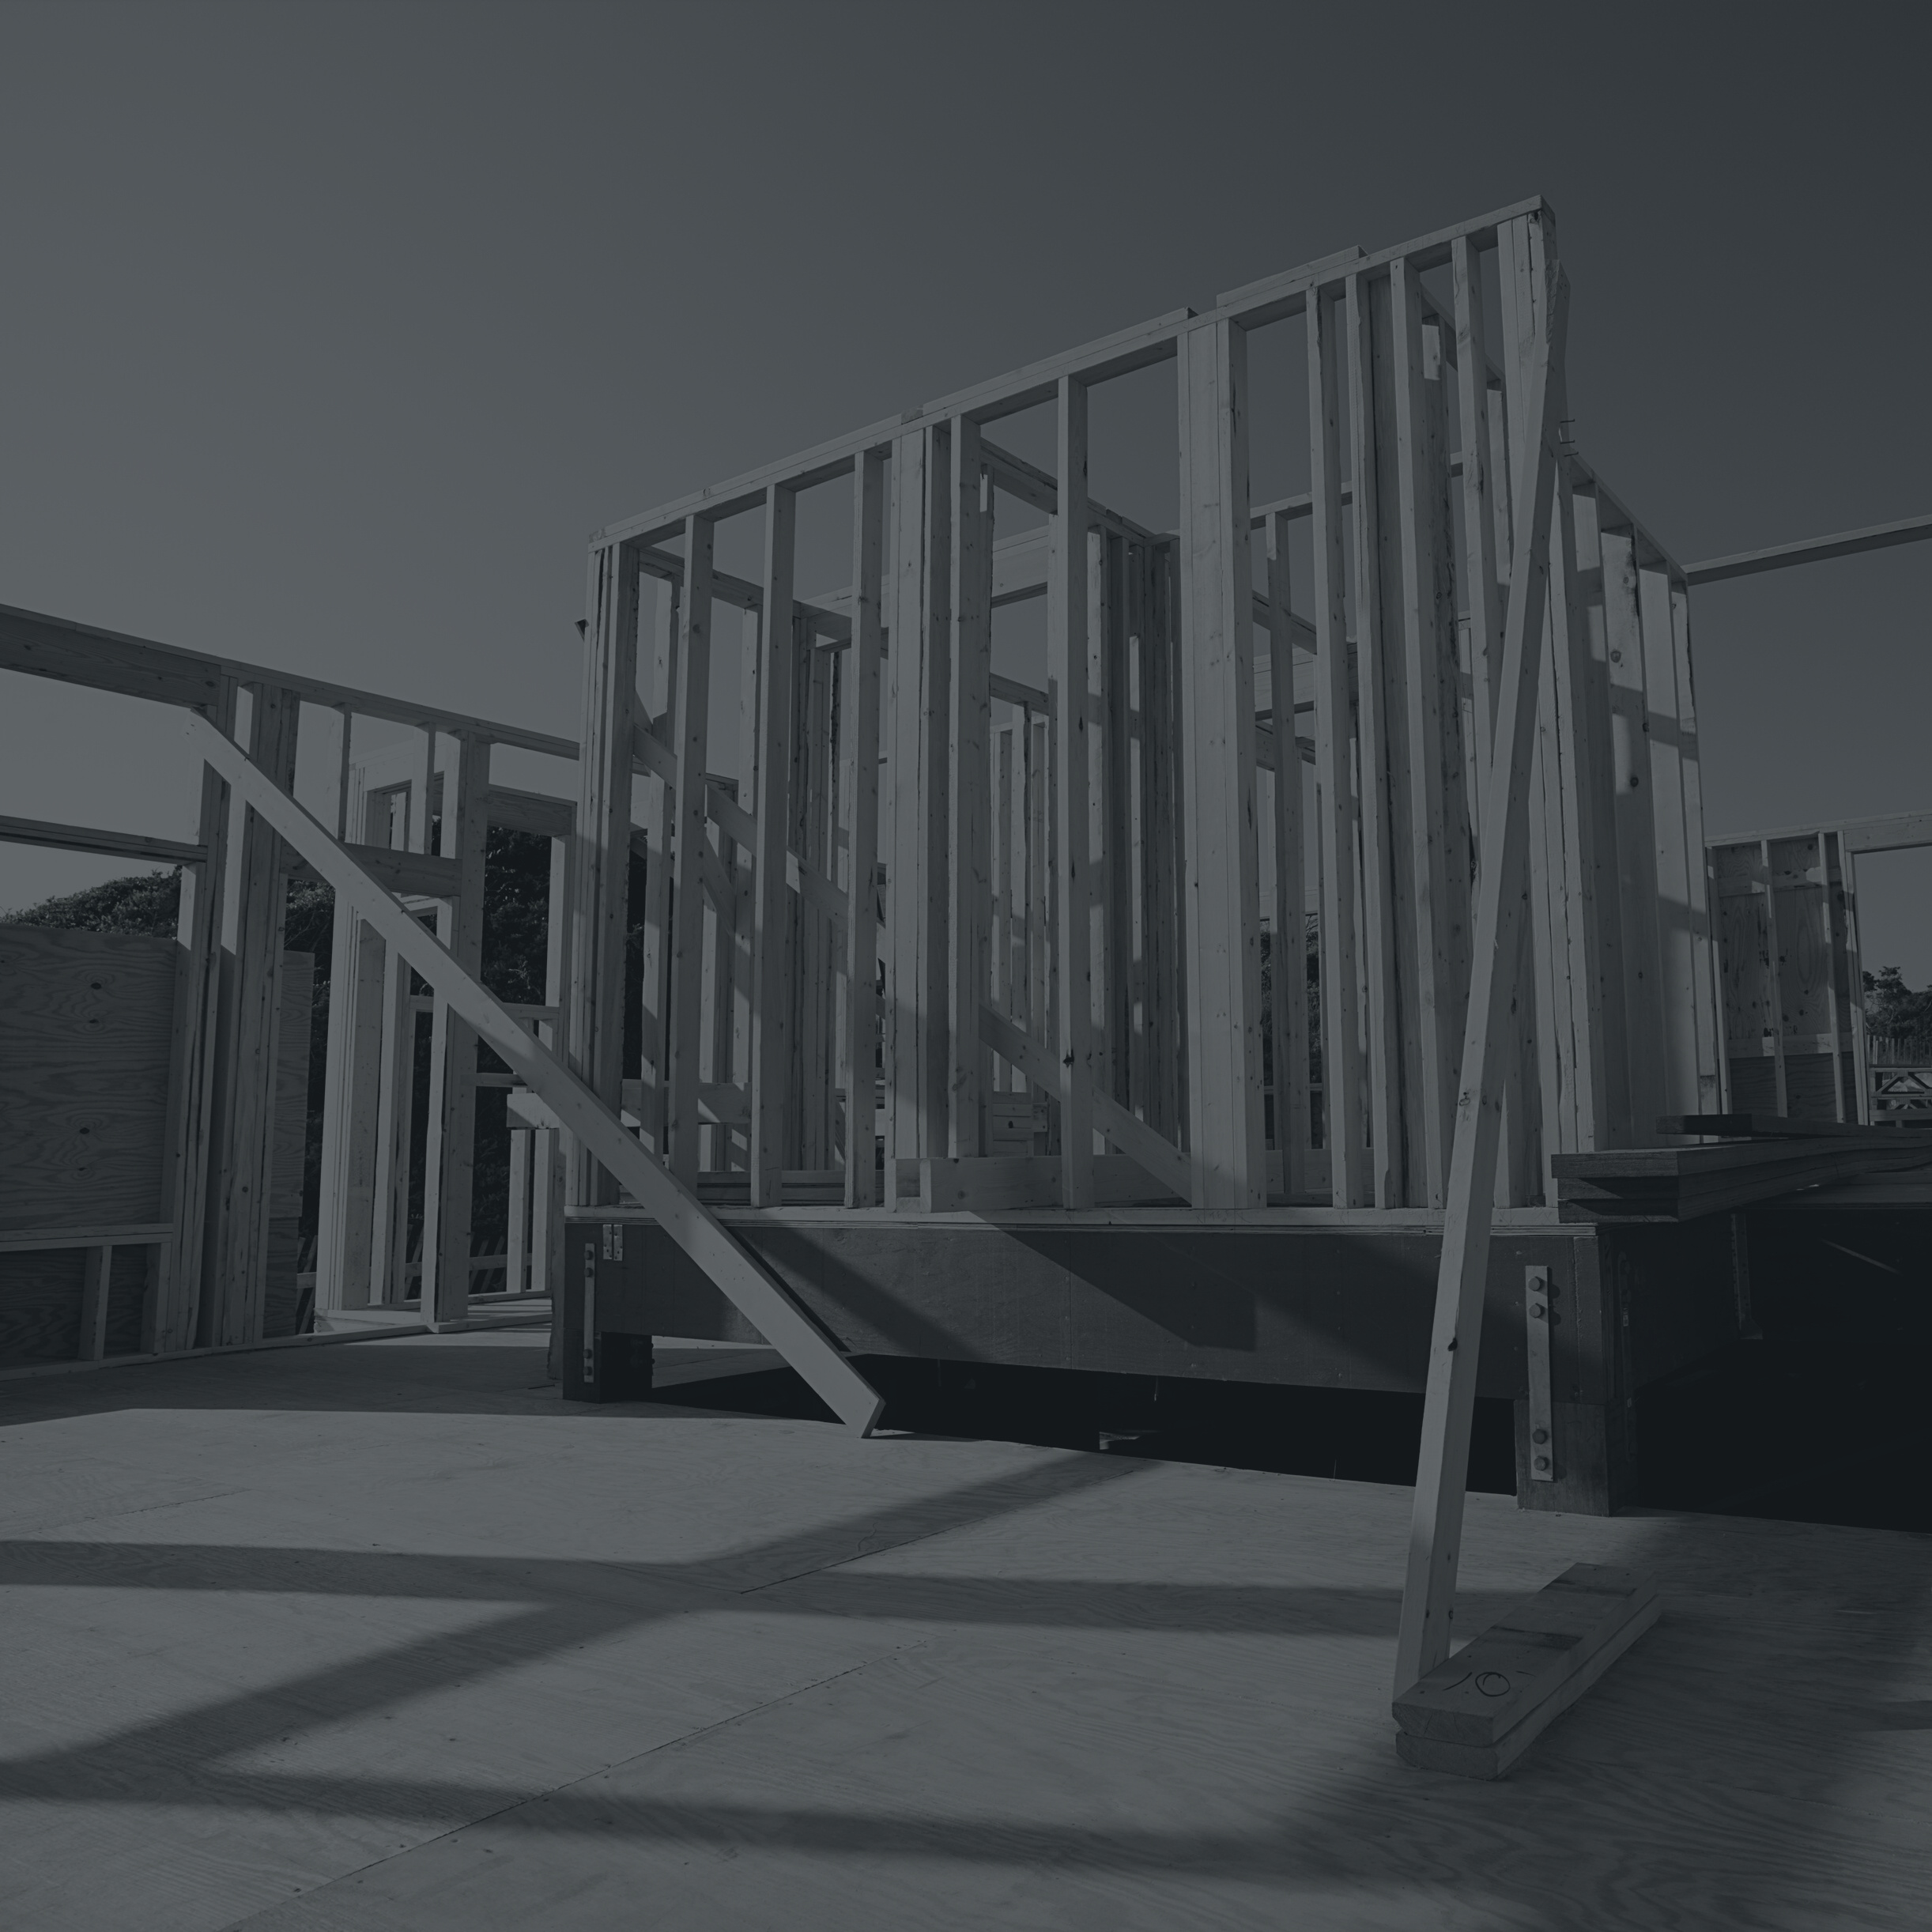
THANK YOU

